Slide 1

Unlocking the Future:
The Transformative Power of Blockchain Technology
BY : BHANU SATISH PUVVALA

Slide 2



Introduction to Blockchain
Blockchain is a decentralized and immutable ledger technology that has the potential to revolutionize various industries. It ensures transparency, security, and eﬃciency in transactions, making it a key player in the future of digital interactions.

Slide 3
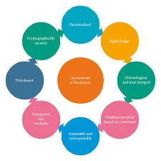
Key Features of Blockchain
The key features of blockchain include decentralization, transparency & security. These characteristics enable users to trust the system without relying on a central authority, fostering a more collaborative environment.

Slide 4
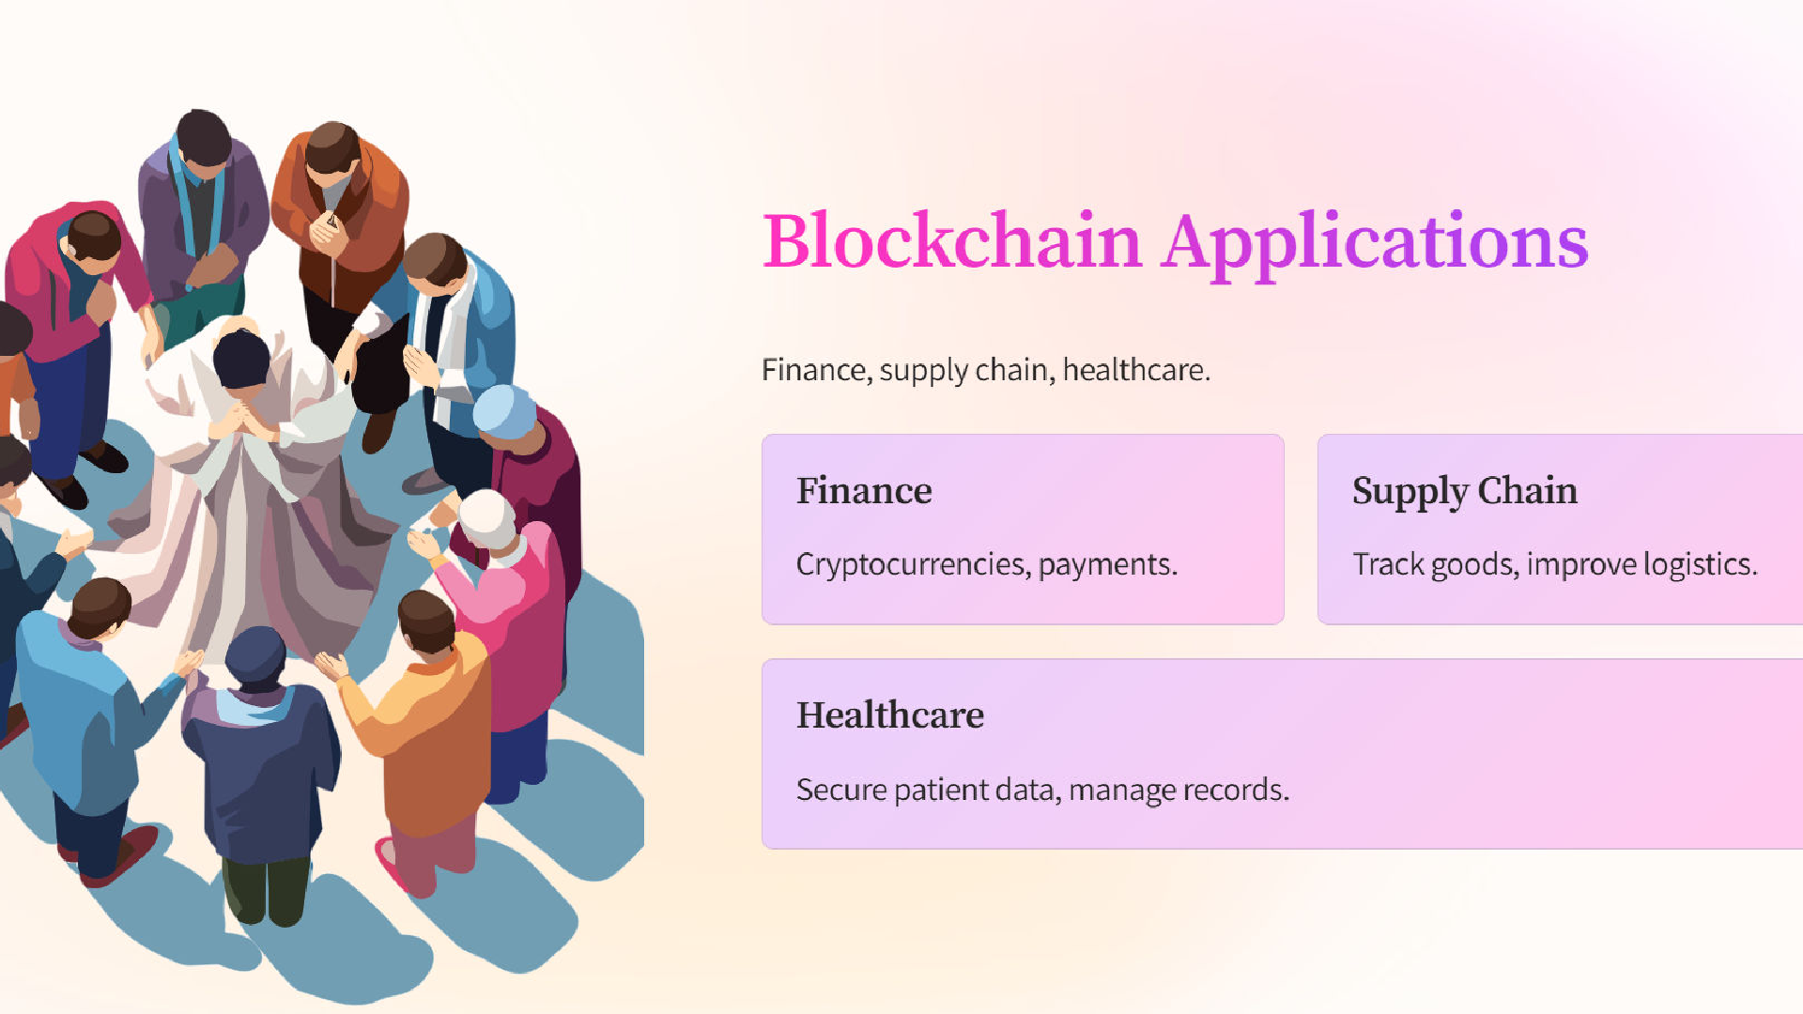

Slide 5

Applications in Finance
In the ﬁnancial sector, blockchain is transforming traditional practices by enabling faster transactions, reducing costs, and enhancing fraud prevention. Cryptocurrencies and smart contracts are prime examples of its impactful applications.

Slide 6


Impact on Supply Chain
Blockchain technology signiﬁcantly enhances supply chain management by enabling real-time tracking and veriﬁcation of products. This boosts accountability, minimizes fraud, and greatly improves the eﬃciency of logistics and inventory control.

Slide 7
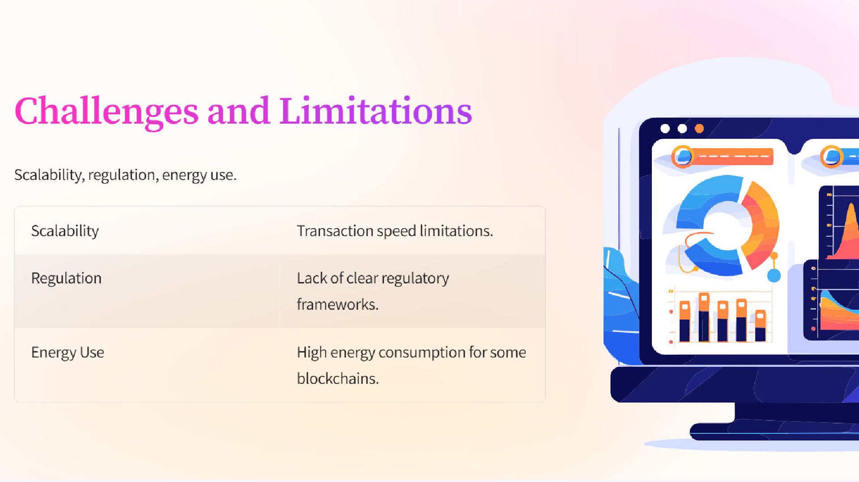

Slide 8

Challenges and Limitations
Despite its potential, blockchain faces challenges such as scalability, regulatory hurdles, and energy consumption.
Addressing these issues is crucial for wider adoption and the realization of its full beneﬁts.

Slide 9
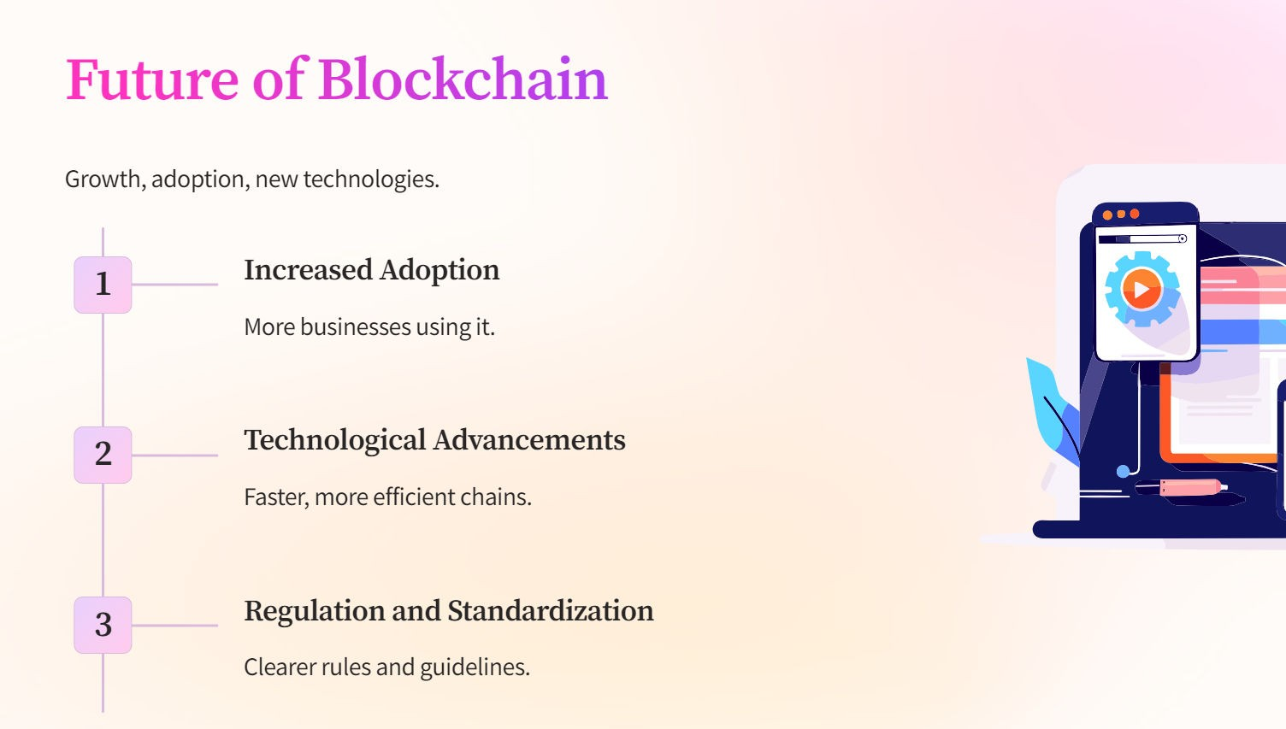

Slide 10


Conclusion: Future Outlook
The future of blockchain technology is promising, with potential applications extending beyond ﬁnance into healthcare, real estate, and government. As challenges are addressed, its transformative power will likely reshape our digital landscape.

Slide 11
Thanks!

